Slide 1
ONLINE INTERACTIVE ENTREPRENEUR CLUB
PIP104 PROFESSIONAL PRACTICE-II
VIVA-VOCE
Batch Number: G-164
Roll Number | Student Name
20201CSE0877 | Savitri Hiremath
20201CSE0898 | Nandini S H
20201CSE0904 | Ranjitha S
20201CSE0046 | Ganapriya H S
Under the Supervision of,
Mr. Jerrin Joe Francis,
Assistant Professor,
School of Computer Science Engineering & Information Science,
Presidency University

Slide 2
Introduction
Entrepreneurs are key drivers of innovation and play a crucial role in economic progress.
They navigate a dynamic business landscape with a strong desire to create, innovate, and influence industries.
Entrepreneurs embody qualities such as resilience, risk-taking, and the transformative power of ideas.
Their pursuit of groundbreaking concepts contributes to economic growth, job creation, and societal advancement.
Despite being catalysts for change, entrepreneurs face challenges, including limited funding opportunities and difficulties in industry collaboration.
Securing adequate funds for business endeavors is often a significant hurdle.
Building partnerships within the industry can be challenging, limiting growth and collaboration potential.
Limited connectivity with peers restricts networking opportunities, shared insights, and mutual support.
The Entrepreneurs Interactive Club addresses these challenges by providing accessible funding avenues, fostering collaboration, and enhancing connectivity.
The club aims to create a multifaceted solution hub, enabling entrepreneurs to thrive in the dynamic entrepreneurial ecosystem.

Slide 3
Literature Review
[1]Social Media Analysis with Machine Learning
Authors: A. M. Khasanova and M. O. Pasechnik
Published in: 2021 IEEE Conference of Russian Young Researchers in Electrical and Electronic Engineering (ElConRus), St. Petersburg, Moscow, Russia
Merits:
This paper delves into social media analysis using machine learning techniques. The study holds promise in advancing our understanding of the applications and implications of machine learning in the context of social media. It contributes to the evolving field by exploring the intersection of social media and advanced analytics.
Challenges:
While the paper showcases merits, challenges may include the need for a more detailed exploration of specific machine learning methodologies employed. Providing insights into the practical implications of the findings and potential real-world applications would enhance the paper's value.

Slide 4
[2]Entrepreneurship in and around Institutional Voids: A Case Study from Bangladesh
Authors: Mair and I. Marti
Published in: Journal of Business Venturing
Merits:
The study provides valuable insights through a focused case study on entrepreneurship in Bangladesh. It illuminates nuanced challenges for entrepreneurs in developing economies, offering significant perspectives on entrepreneurial dynamics.
Challenges:
Despite its merits, the study faces inherent limitations of case studies, limiting generalizability. Enhancing relevance by addressing the temporal aspect and considering changes over time is crucial.

Slide 5
[3]Saudi Female Entrepreneurs, Situation and Challenges
Authors: H. Alsulami and R. Abutaha
Published in: 2018 Portland International Conference on Management of Engineering and Technology (PICMET), Honolulu, HI, USA
Merits:
This study explores the situation and challenges faced by Saudi female entrepreneurs. The focused examination provides valuable insights into the unique aspects of entrepreneurship in the Saudi context, shedding light on the experiences and obstacles like funding encountered by women entrepreneurs.
Challenges:
Despite its merits, the study may face challenges in generalizability beyond the specific Saudi context. An enhanced exploration of the identified challenges and potential solutions could strengthen the paper's practical implications.

Slide 6
[4]How entrepreneurial SMEs compete through digital platforms: The roles of digital platform capability, network capability, and ambidexterity
Authors: Javier Cenamor, Vinit Parida, Joakim Wincent Published in: Journal of Business Research, 2019/04/03
Merits:
This study explores how entrepreneurial SMEs excel in the digital landscape. Focusing on digital platform capability, network capability, and ambidexterity, the research provides key insights into the strategies driving competitiveness. It significantly contributes to understanding how small and medium-sized enterprises leverage digital platforms for a competitive edge.
Challenges:
While valuable, a deeper dive into SME strategies on digital platforms would enhance practical insights. More exploration of real-world implications and challenges faced by SMEs in the digital realm would strengthen the paper. How Entrepreneurial SMEs Compete through Digital Platforms: The Roles of Digital Platform Capability, Network Capability, and Ambidexterity effectively through digital platforms

Slide 7
[5]Toward entrepreneurial pedagogies: Rethinking professional networking as knowledge making
Authors: B. Lauren, S. Pigg
Published in: 2016 IEEE International Professional Communication Conference (IPCC), Austin, TX, USA
Merits:
Presented at the 2016 IEEE International Professional Communication Conference, the study delves into rethinking professional networking as a form of knowledge creation. The paper offers valuable insights into the intersection of entrepreneurial education and professional networking, challenging traditional perspectives and paving the way for innovative pedagogical approaches.
Challenges:
While commendable, the paper's abstract doesn't provide specific details about the methodologies or specific cases explored. A more in-depth examination of practical examples or case studies could enhance the paper's applicability.

Slide 8
[6]The impact of social networks on technology entrepreneurs’ opportunity recognition process
Authors: W. Lim, Y. Lee
Published in: 2019 7th International Conference on Information and Communication Technology (ICoICT), Kuala Lumpur, Malaysia
Merits:
The study explores the intricate relationship between social networks and the identification of entrepreneurial opportunities within the technology sector. The paper contributes valuable insights into the dynamics that shape entrepreneurs' perceptions and actions in recognizing opportunities within the evolving landscape of technology.
Challenges:
While promising, the abstract lacks specifics about the methodologies employed or the scope of the technology sector covered. A more detailed explanation of the research design and the specific impact on technology entrepreneurs' opportunity recognition would enhance the paper's depth.

Slide 9
[7]Entrepreneurship through the platform strategy in the digital era: Insights and research opportunities
Authors: Ying-Jiun Hsieh, Yenchun Wu
Published in: Computers in Human Behavior, 2019/06/01
Merits:
The study offers valuable perspectives on how entrepreneurs navigate and capitalize on digital platforms. The paper contributes to understanding the dynamics of entrepreneurship in the evolving digital landscape, identifying research opportunities for further exploration.
Challenges:
While commendable, the abstract does not delve into specific methodologies employed or the particular focus within the digital era. A more detailed overview of the insights and potential research avenues explored would enhance the paper's applicability.

Slide 10
[8]Entrepreneurship in Digital Platforms: A Network Centric View
Authors: Arati Srinivasan, N. Venkatraman
Published in: Strategic Entrepreneurship Journal, 2017/09/09, Volume 12
Merits:
The study offers a nuanced view of how entrepreneurs engage in digital ecosystems. The paper provides valuable insights into the intricate dynamics of entrepreneurship in the context of digital platforms, emphasizing the role of networks.
Challenges:
The abstract lacks specific details about the methodologies employed or the focus within digital platforms. A more detailed overview of the network-centric view and its implications for entrepreneurship would enhance the paper's practical relevance.

Slide 11
[9]The Research Review of Entrepreneur Social Network
Author: Yonghai Yu
Published in: 2010 International Conference on Networking and Digital Society, Wenzhou
Merits:
The study offers a comprehensive overview of the existing body of research in the domain of entrepreneur social networks. The paper provides valuable insights into the evolution and current state of understanding in this field.
Challenges:
The paper lacks specific details about the depth and scope of the research review presented. A more comprehensive outline of key themes, trends, or gaps identified in entrepreneur social network research would enhance the paper's practical relevance.

Slide 12
[10]Pitching as a Communication Technology and Pitch as a Tool for Investor Relations in the Digital Environment
Authors: L. V. Balakhonskaya, V. V. Balakhonsky
Published in: 2021 Communication Strategies in Digital Society Seminar (ComSDS), St. Petersburg, Russia
Merits:
This paper explores the role of pitching as a communication technology and its application in investor relations within the digital environment. The study, presented at the Communication Strategies in Digital Society Seminar, sheds light on the evolving dynamics of communication strategies, especially in the context of pitching. The paper contributes to understanding how digital platforms shape and influence investor relations.
Challenges:
While valuable, the paper may benefit from a more detailed examination of specific case studies or examples illustrating the application of pitching in the digital context. Providing practical insights into the challenges and opportunities faced by individuals or businesses using pitching for investor relations would enhance the paper's applicability.

Slide 13
Research Gaps Identified
1. The Entrepreneur Club lacks events and webinars, prompting research into their potential benefits and strategies for integration to bring about positive change and growth.
2. The club currently restricts multimedia content to pictures, excluding videos. Research is underway to understand the impact on member interaction, knowledge-sharing, and community vibrancy, with the aim of finding opportunities for improvement.
3. Entrepreneurs face financial challenges, and the research focuses on evaluating the club's effectiveness in providing accessible funding. This includes exploring different funding mechanisms, success rates, and the overall impact on overcoming financial barriers.
4. Collaboration within industries remains a challenge for entrepreneurs. The research investigates the club's role in facilitating industry-wide collaborations, examining existing partnerships, identifying collaboration barriers, and proposing strategies for improvement.

Slide 14
Proposed Methodology
We propose a comprehensive methodology for developing the web app, focusing on leveraging machine learning for intelligent collaboration recommendations while prioritizing user security through robust authentication measures.
Our step-by-step plan ensures a secure, user-friendly experience, emphasizing continuous feedback integration for iterative improvements.
We commit to promoting clarity in app architecture and fostering a dynamic, collaborative community within the Entrepreneur's Interactive Club.

Slide 15
Objectives
Establish the Online Interactive Entrepreneur Club as a comprehensive support system.
Address challenges related to connection and funding for entrepreneurs.
Integrate cutting-edge machine learning models for intelligent funding recommendations, emphasizing empowerment for entrepreneurs and investors within the ecosystem.

Slide 16
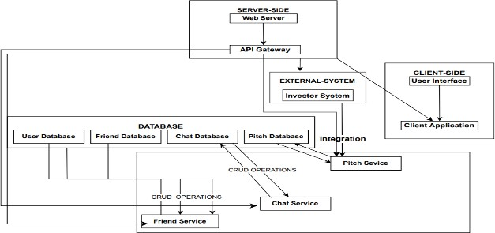
System Design and Implementation
Fig 1. Architecture Diagram

Slide 17
This diagram illustrates a multi-tier web application with server-side and client-side components.
On the server-side, the web server contains logic for handling client requests and interacts with databases and external systems.
The API Gateway serves as a central entry point for client-side applications, routing requests to appropriate services and managing communication.
The client-side involves the user interface responsible for rendering and sending user input to the server.
An external system, like the Investor System, interacts with the web application for investment-related functionalities.
Databases include User, Friend, Chat, and Pitch databases, storing various user-related and application-specific data.
Integration represents connections between different parts, managing data flow between databases, services, and external systems.
The API Gateway efficiently manages and routes requests, while services handle distinct functionalities for a modular and scalable system.

Slide 18
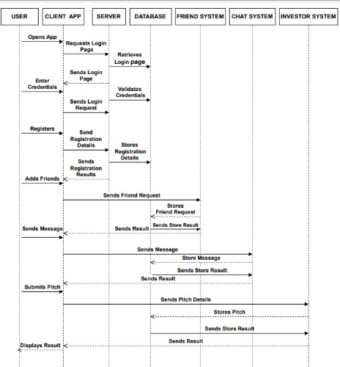
Sequence Diagram
1.Users access the login page, enter credentials, and the server verifies the login request.
2. Registration involves users providing details to the server, which stores the information and communicates the results.
3. Friend interactions include adding friends, sending friend requests, and the server storing these requests, along with handling message transmission.
4. Messaging allows users to send messages, with the server storing and displaying the results.
5. Pitch submission entails users sending pitches, and the server storing details while presenting the final outcome.
Fig 2. Sequence Diagram

Slide 19
Modules
Login module
Authentication : The login module includes a secure authentication mechanism to verify the identity of users attempting to access the system. This involves validating credentials such as usernames and passwords through robust encryption methods.
Access Control : Once authenticated, the login module enforces access control policies to determine the level of permissions granted to the user. This ensures that users have appropriate and authorized access to specific resources or functionalities within the system.
Investor module
The Investor Module provides tools for investors to manage their investment portfolios efficiently.
This feature assists investors in discovering and evaluating potential investment opportunities. The Investor Module may include a deal discovery platform where investors can explore various projects or businesses seeking funding.

Slide 20
Home module
The Home Module provides users with a personalized dashboard that offers a snapshot of relevant information and activities. This may include a summary of recent notifications, account status, or key metrics related to the user's engagement with the platform.
It serves as a central hub for navigation, offering quick access to various modules and features within the platform. Users can easily navigate to different sections, such as profiles, settings, or specific functional modules, directly from the Home Module.
Admin Module
The Admin Module includes features for managing user accounts and permissions. Administrators can create, modify, or deactivate user accounts, assign roles, and control access levels. This functionality ensures proper security and compliance with organizational policies.
This module allows administrators to configure and customize various settings within the system. It may include options to modify system parameters, set up notifications, and adjust overall system behavior. System configuration tools help tailor the platform to meet specific organizational needs.

Slide 21
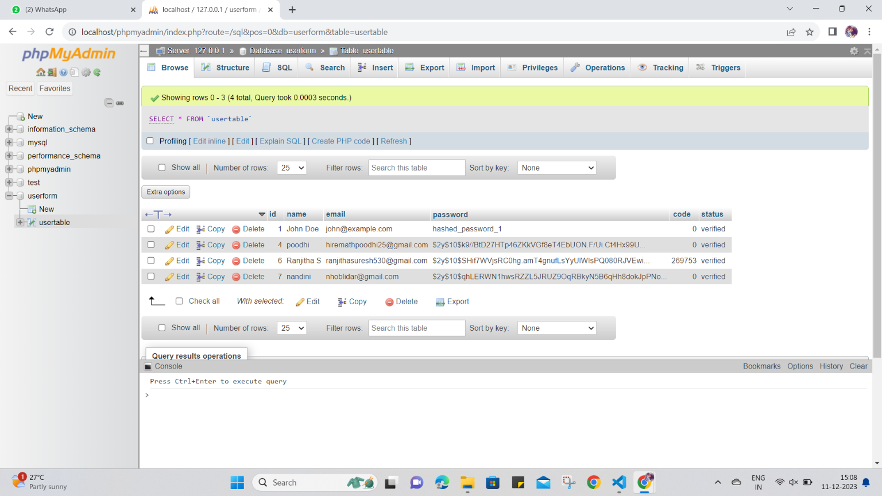
Database Module
The database consists of a table with six columns: id, name, email, password, code, and status.
Name and email columns are varchar with a maximum length of 255 characters, suitable for storing names and email addresses.
The password column, also varchar, has a maximum length of 255 characters, designed for secure storage of user passwords.
The code column is specified as a medium integer with a length of 50, likely used for storing activation codes or similar numerical values.

Slide 22
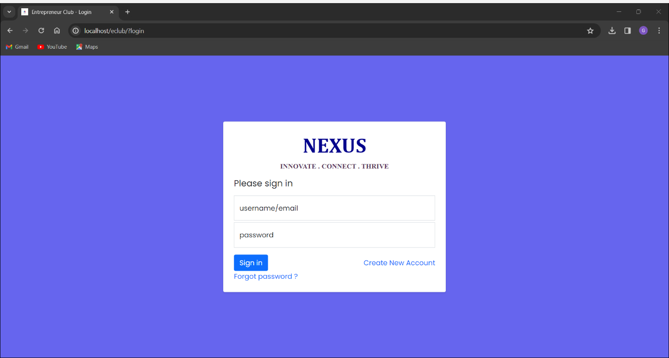
Login Module
This module defines a user login form with effective styling. It includes a title, "NEXUS," a subtitle, "INNOVATE . CONNECT. THRIVE," and a form for users to input their email and password.
The form is connected to the server-side logic through the action attribute, pointing to "login-user.php," where the authentication process is handled.
The form fields include email and password inputs, and any errors during login attempts are displayed in a red alert box.
The form also includes a "Forgot password?" link that directs users to a password recovery page.

Slide 23
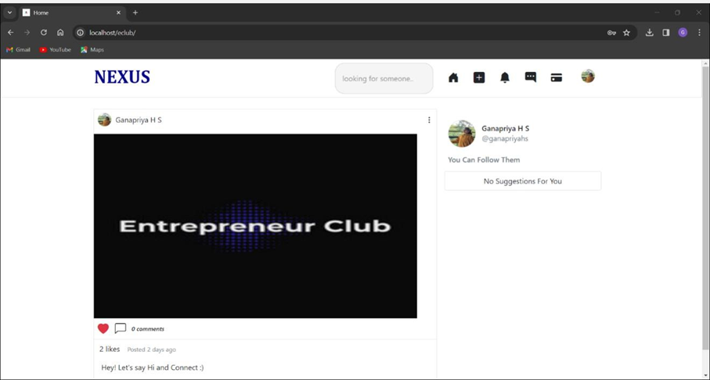
Home Page Module

Slide 24
Home Page
The home page includes:
1. Profile Details: Users can input extensive professional information, enhancing clarity on each member's skills and interests.
2. Posting: Encourages members to share updates, insights, or project details. Consider organizing posts into categories for improved structure.
3. Liking and Commenting: Features designed to cultivate a sense of community. Ensure user-friendly interactions that promote positivity.
4. Chatting: Private messaging or group chat features facilitate direct communication, fostering meaningful connections among members.

Slide 25
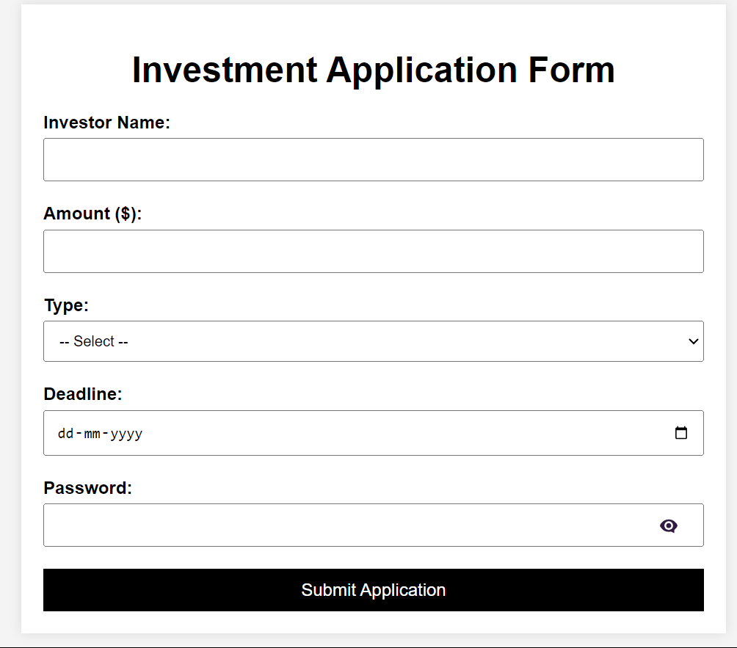
Investment Module
The Investor’s should fill in the form with the details like Amount, Type etc.
The password should have minimum 1 caps, 1 small letter, 1 digit, 1 symbol and it will be stored in the database in hashed format for security reasons.
The investment announcement will be available in the funding section for all entreprenuer’s to view and apply

Slide 26
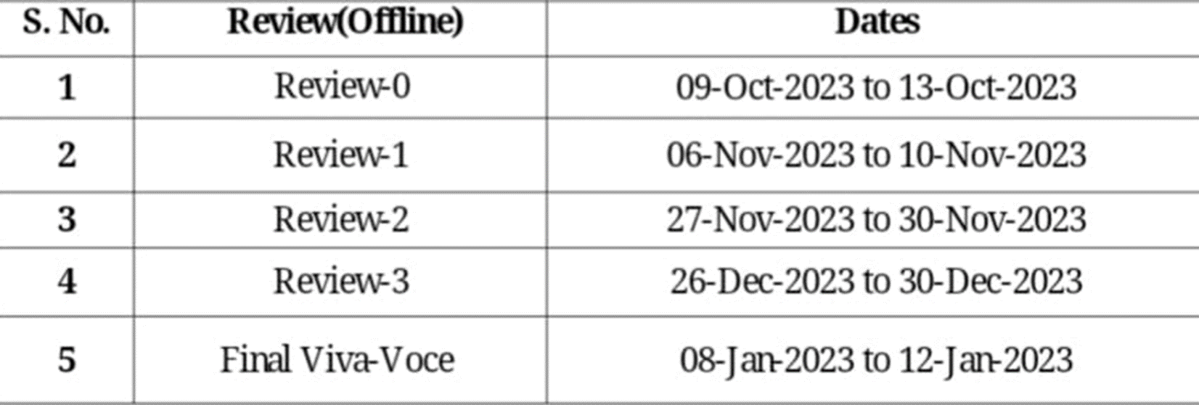
Timeline of Project

Slide 27
Outcomes / Results Obtained
This entrepreneurial platform offers valuable outcomes for its members:
1)Expanded Professional Network: Entrepreneurs can seamlessly connect with like-minded individuals, potential collaborators, or investors, thereby expanding their professional network and fostering mutually beneficial relationships.
2)Collaboration and Partnership Opportunities: Members have the opportunity to discover collaboration prospects, joint
ventures, or partnerships within the club, creating a conducive environment for entrepreneurial synergy.
3)Continuous Improvement Through Member Feedback: The club undergoes continuous improvement, evolving basedon member feedback, ensuring that it remains relevant, dynamic, and consistently valuable to its entrepreneurial community.

Slide 28
4)Dedicated Investment and Funding Platform: The platform serves as a dedicated space where members can explore
investment opportunities, pitch ideas, and connect with potential investors or funding sources, fostering an ecosystem for financial growth.
5)Informed Decision-Making for Investors: Investors benefit from recommendations based on projected revenue,
enabling them to make informed decisions. This feature enhances the platform's value by providing data-driven insights to investors, contributing to more strategic investment choices.
.

Slide 29
Registration
This is a registration form with Bootstrap styling. The form includes fields for the user to input their full name, email address, password, and confirm password.
The form includes a dynamic section to display error messages. If there is exactly one error, it will be shown as a single alert.
If there are multiple errors, they will be displayed as an unordered list for better readability.
Overall, it establishes the structure of a user-friendly registration interface with input validation and error handling.

Slide 30
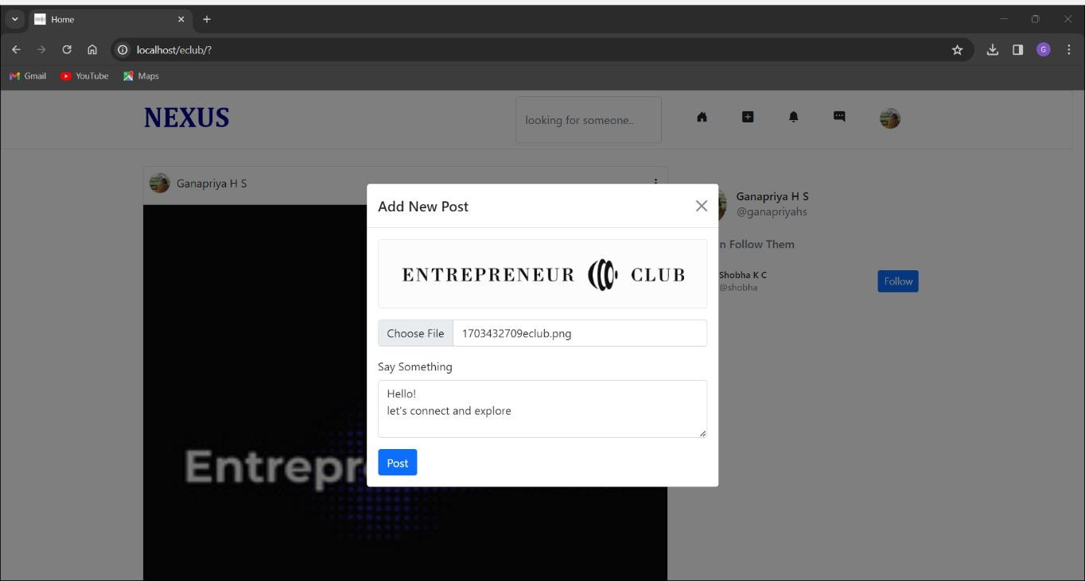
Home Page : Navigation bar : Post
This allows the users to post the content. Once the post content is selected it saves in the database having the updates in his profile too.

Slide 31
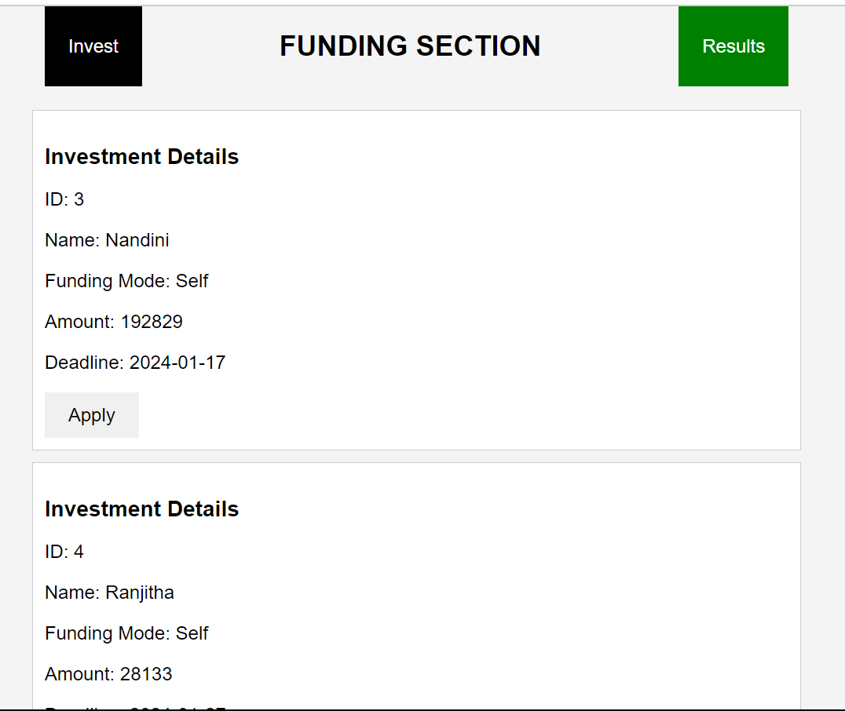
Funding Section
The funding section contains all the investment announcements released by the investors.
It also contains Results button, which upon clicking will proceed to the login form. Here investors and entreprenuers should enter their credentials to view the result.
The apply button in each announcement will allow the entreprenuers to apply to that particular investment.
The entries will be stored in the database.

Slide 32
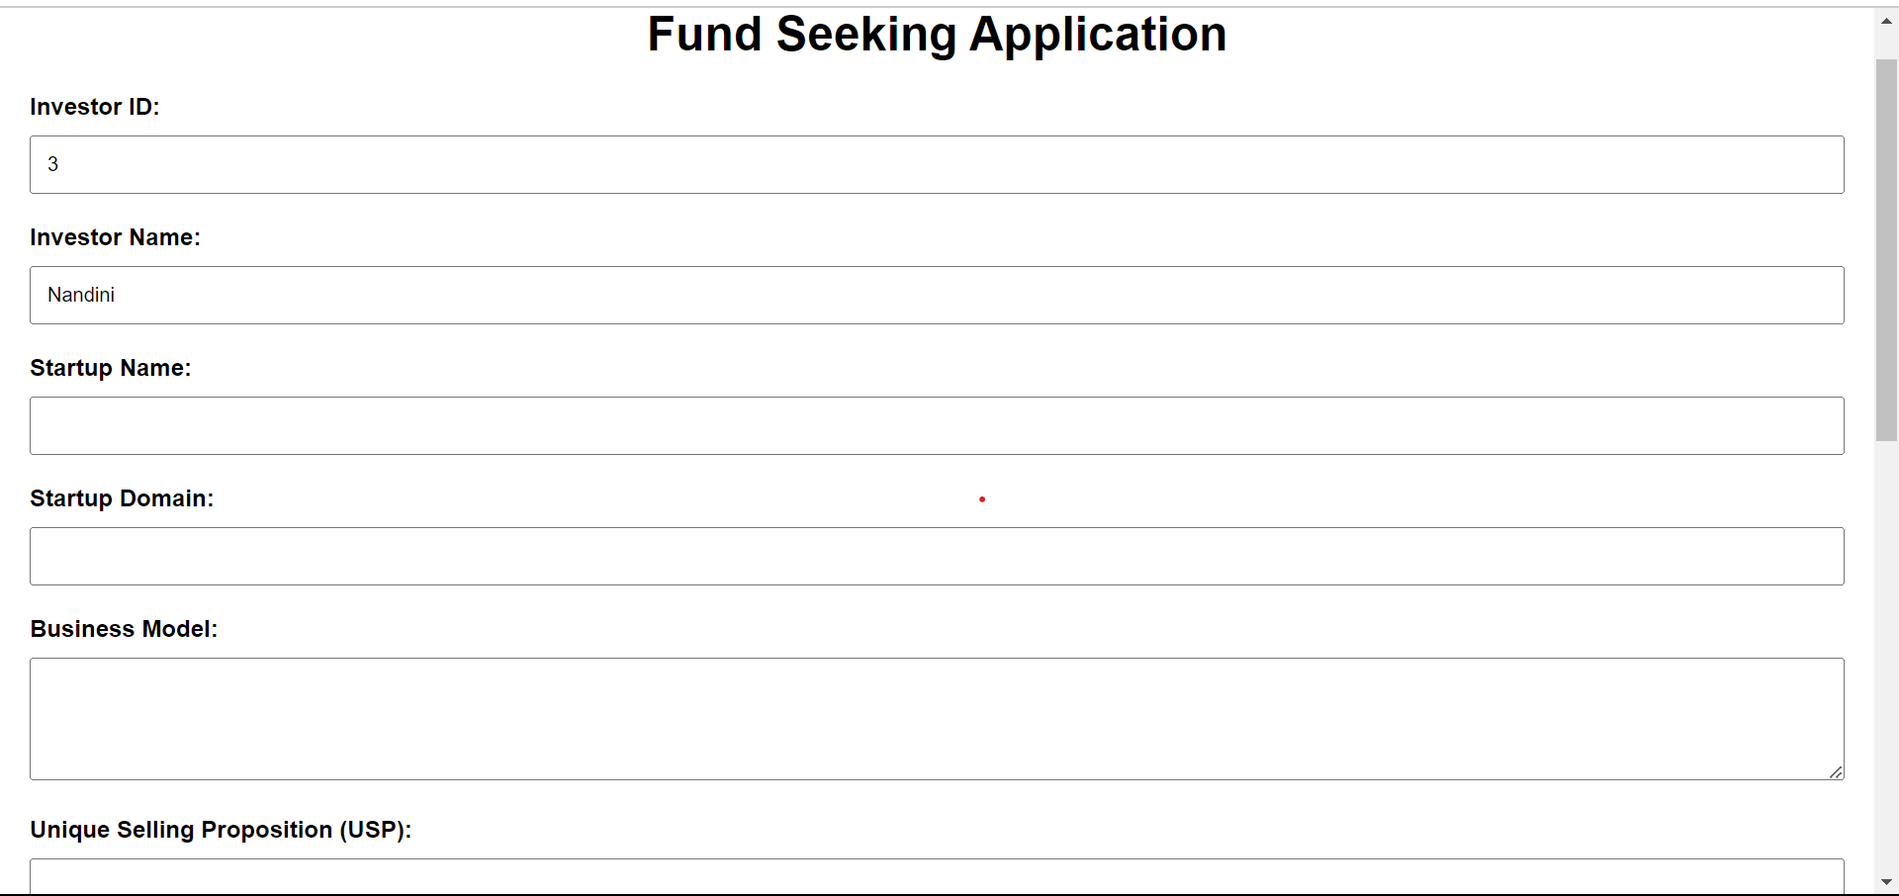
Entreprenuer’s Application
The Entreprenuer’s should fill in the details and it will be stored in the database.
The results sections will stores these entries in the particular investment they the Entreprenuers have applied.
The ID, Investor Name will be displayed while filling the form and the same will be stored in the database.

Slide 33
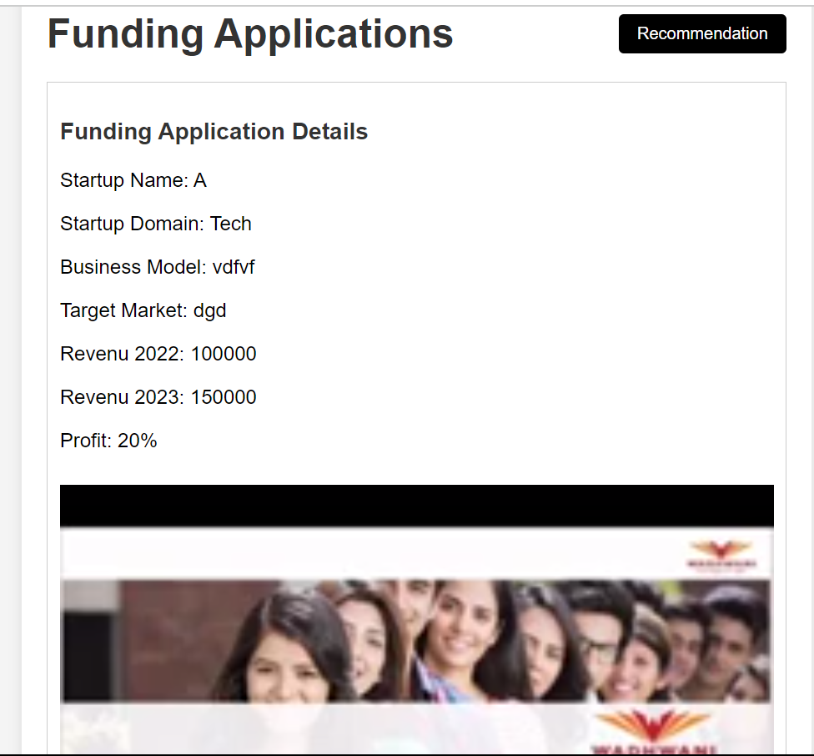
Investor’s View Page
The investor opens the web browser and navigates to the "Investor View" page.
When the page loads, the php file is executed.
The fetchData function is triggered, making an asynchronous request to the server to fetch startup data.
The dynamically generated HTML, including startup names, images, industry types, revenues, profits, growth rates, and pitching videos, is injected into the designated div element on the page The investor view page is now populated with information about various startups.
Each startup's details, including business model images, industry types, financials, and pitching videos, are displayed.

Slide 34
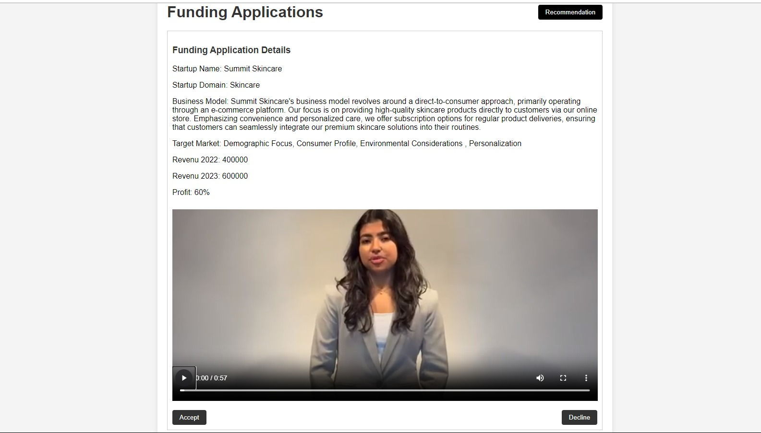
Application view page for Investors
In reviewing the funding application
1. Startup details include the name, domain, and business model.
2. Financial information consists of revenue and profit.
3. Decision options are to either approve the application or reject it.

Slide 35
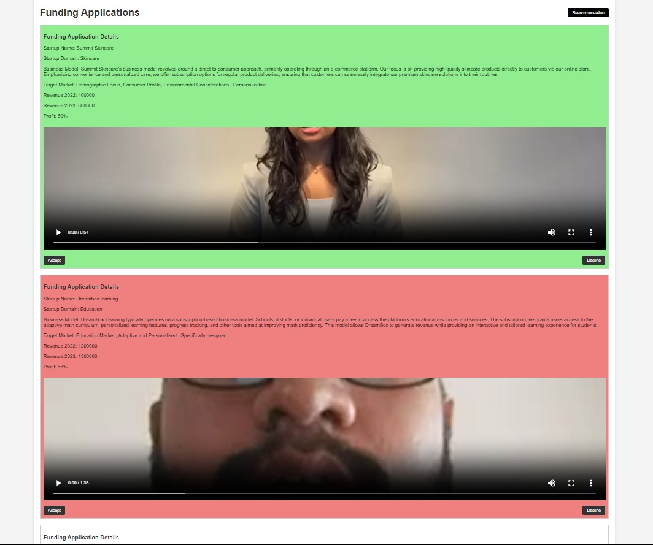
Fund Application Results
1. Accepted applications are highlighted in green.
2. Rejected applications are marked in red.
3. Applications yet to be reviewed or decided retain the default white color.

Slide 36
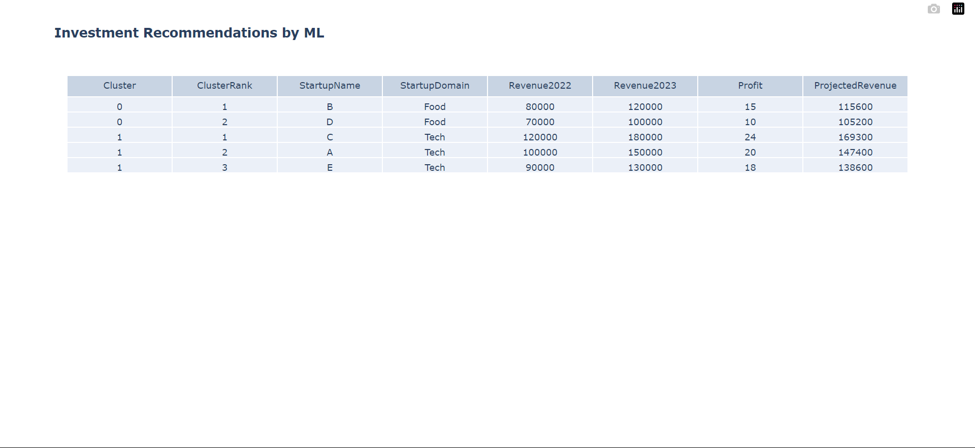
Recommendations by ML
The recommendations are based on K-Clustering model and Random Forest Regressor.
The K-Clustering model will group the investments into clusters.
These clusters are then ranked in order and the projected revenue for 2024 is obtained using Random Forest Regressor.
The obtained result is displayed in tabular format.

Slide 37
Conclusion
1. The online entrepreneur club functions as a supportive hub, creating an environment for entrepreneurs to connect and thrive, drawing inspiration from industry peers and diverse sectors.
2. Through strategic planning and proactive methods, the club fosters a lively community, encourages knowledge sharing, and provides valuable support, facilitating connections within and beyond one's industry.
3. Within the club, businesses flourish, partnerships form, and members enhance their skills through meaningful interactions, contributing to individual and collective growth.
4. It serves as a space where entrepreneurs not only grow individually but also connect with others in their industry, gaining insights and inspiration.
5. The club offers valuable funding opportunities for entrepreneurs and assists investors in making informed decisions, contributing to the overall growth and innovation in the entrepreneurial community.
6. In summary, the online entrepreneur club is a dynamic space that goes beyond personal development, playing a pivotal role in the entire entrepreneurial journey. It ensures members connect within their industry and draw inspiration from the broader entrepreneurial landscape.

Slide 38
References
[1]A. M. Khasanova and M. O. Pasechnik, "Social Media Analysis with Machine Learning," 2021 IEEE Conference of Russian Young Researchers in Electrical and Electronic Engineering (ElConRus), St. Petersburg, Moscow, Russia, 2021, pp. 32-35, doi: 10.1109/ElConRus51938.2021.9396713.
[2]Mair and I. Marti, “Entrepreneurship in and around institutional voids:
A case study from Bangladesh,” J. Bus. Venturing, vol. 24, no. 5, pp. 419– 435, 2009.
[3]H. Alsulami and R. Abutaha, "Saudi Female Entrepreneurs, Situation and Challenges," 2018 Portland International Conference on Management of Engineering and Technology (PICMET), Honolulu, HI, USA, 2018, pp. 1-6, doi: 10.23919/PICMET.2018.8481859
[4]Cenamor, Javier & Parida, Vinit & Wincent, Joakim. (2019). How entrepreneurial SMEs compete through digital platforms: The roles of digital platform capability, network capability, and ambidexterity. Journal of Business Research. 100. 196-206. 10.1016/j.jbusres.2019.03.035.

Slide 39
[5]B. Lauren and S. Pigg, "Toward entrepreneurial pedagogies: Rethinking professional networking as knowledge making," 2016 IEEE International Professional Communication Conference (IPCC), Austin, TX, USA, 2016, pp. 1-4, doi: 10.1109/IPCC.2016.7740535.
[6]W. Lim and Y. Lee, "The impact of social networks on technology entrepreneurs’ opportunity recognition process," 2019 7th International Conference on Information and Communication Technology (ICoICT), Kuala Lumpur, Malaysia, 2019, pp. 1-7, doi: 10.1109/ICoICT.2019.8835289.
[7]Hsieh, Ying-Jiun & Wu, Yenchun. (2019). Entrepreneurship through the platform strategy in the digital era: Insights and research opportunities. Computers in Human Behavior. 95. 315-323. 10.1016/j.chb.2018.03.033.
[8]Srinivasan, Arati & Venkatraman, N.. (2017). Entrepreneurship in Digital Platforms: A Network Centric View. Strategic Entrepreneurship Journal. 12. 10.1002/sej.1272.

Slide 40
[9]Yonghai Yu, "The research review of entrepreneur social network," 2010 International Conference on Networking and Digital Society, Wenzhou, 2010, pp. 244-248, doi: 10.1109/ICNDS.2010.5479357.
[10]L. V. Balakhonskaya and V. V. Balakhonsky, "Pitching as a Communication Technology and Pitch as a Tool for Investor Relations in the Digital Environment," 2021 Communication Strategies in Digital Society Seminar (ComSDS), St. Petersburg, Russia, 2021, pp. 166-172, doi: 10.1109/ComSDS52473.2021.9422852

Slide 41
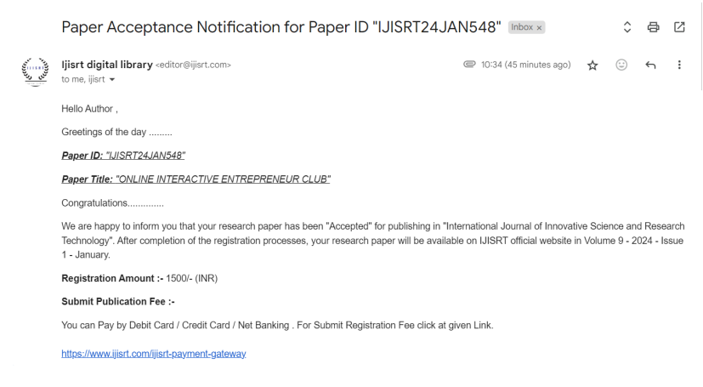
Publication Details

Slide 42
Thank You

